Slide 1
Motion Sensor Cat Gate
An IST360 IOT Project
Chaoyi Wang

Slide 2
Problem Description
I have a cat.
There are certain areas in the house that I do not want him to pass.
Like the area that I just sprayed ant killer.
Pet gates are expensive and sometimes don’t work in open area
And my cat can jump over them.
I need something budget friendly and can stop my cat.

Slide 3
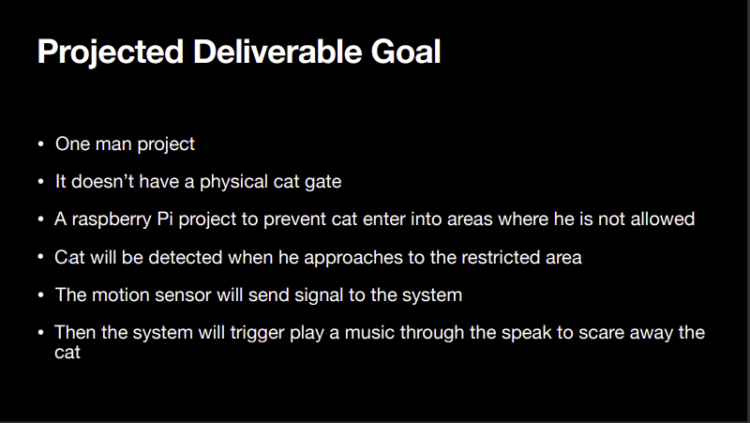

Slide 4
Proposed Solution
Utilizing PIR motion sensors to track movements
Dual sensor to differentiate movements of cat from human
Store all captured movements into database
View & track each recorded data
Sound an alarm when cat detected

Slide 5
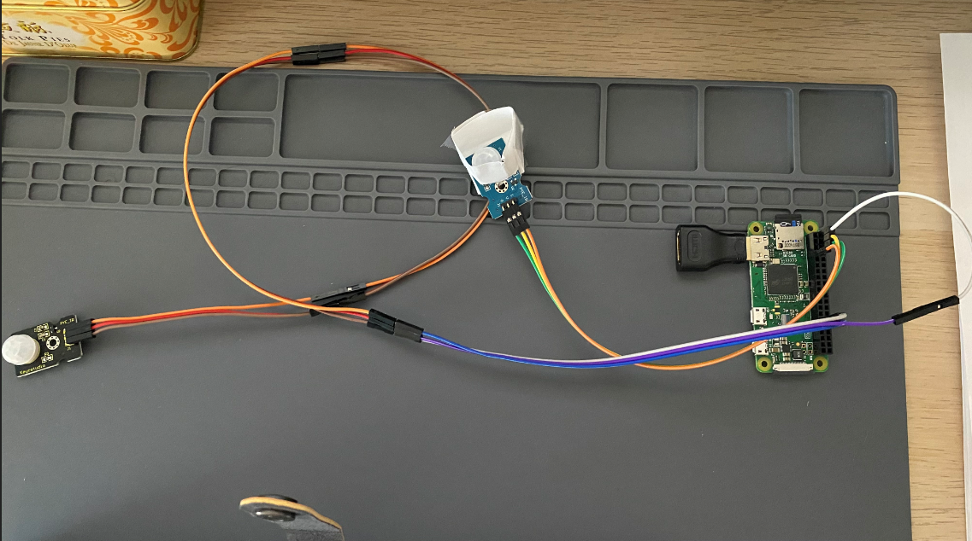
Current Setup
One RPi Zero W
Soldered female header
Jump wires
Two PIR sensors
Sensor A use pin 12 and sensor B use pin4
Sensor A will be placed about 1/2’ above the floor
Sensor B will be placed about 4‘ above the floor
B
A

Slide 6
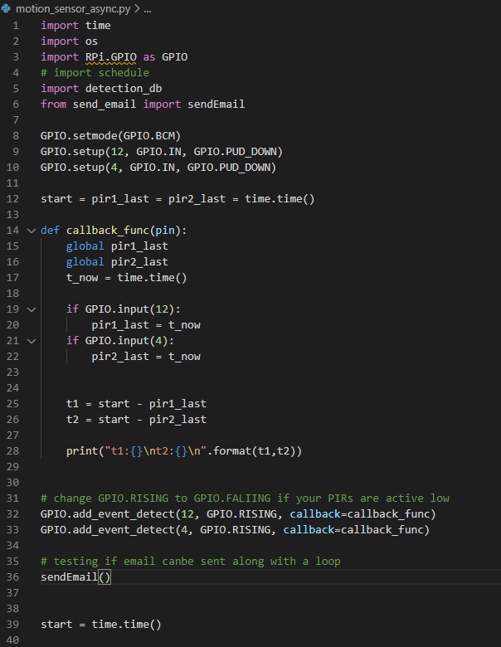
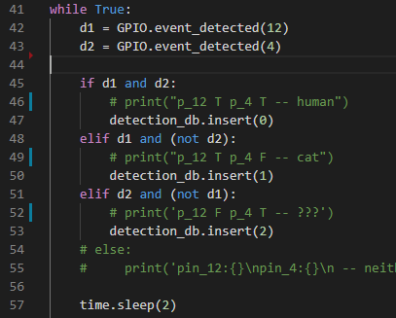
PIR Motion Detection
Two PIR sensors
Sensor A use pin 12 and sensor B use pin4
Sensor A will be placed about 1/2’ above the floor
Sensor B will be placed about 4 feet above the floor

Slide 7
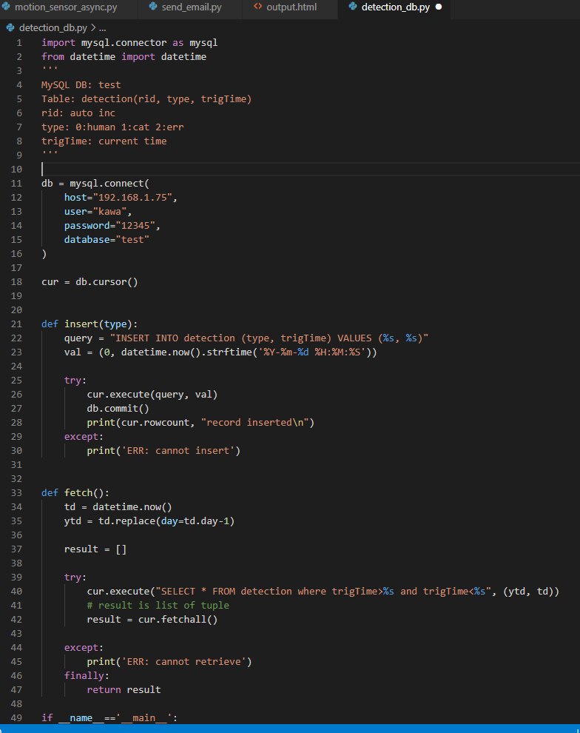
Connect to Database
Setup MySQL database on local NAS
DB’s remote access only available within the local network
Python script remotely connect to the database through mysql connector
Functions to insert and fetch records

Slide 8
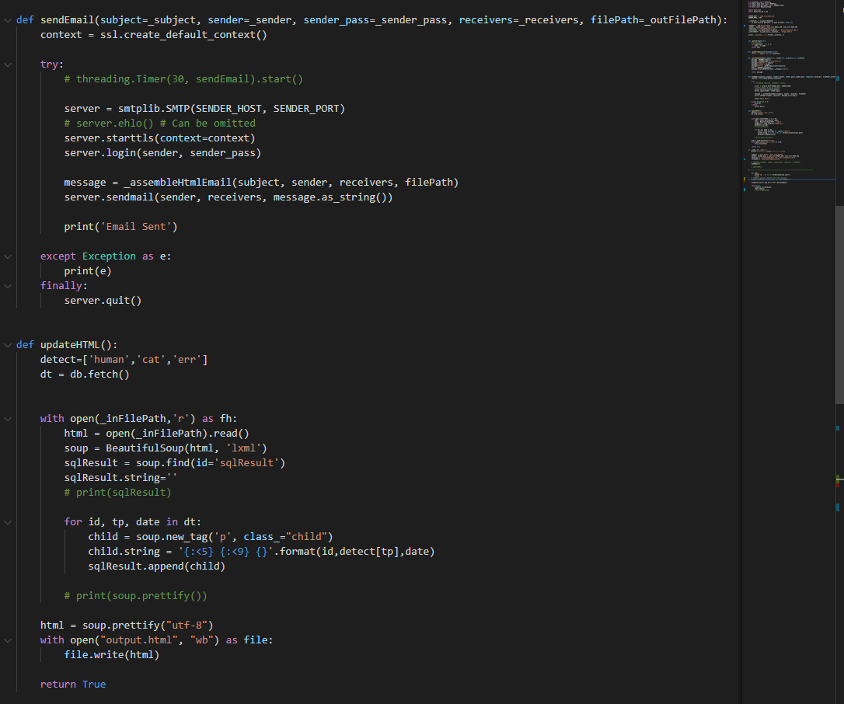
Email Daily Report
A scheduled task to send daily email contains the past 24hrs passing through records
Fetch records from database
Insert the records into an HTML file
Email the HTML file
Scheduling: 2 solution: threading.Timer() vs. schedule (python module)

Slide 9
Changes & Challenges
Use two PIR sensors instead of one
Advantage: one PIR cannot differentiate cat from human passing through
Cat can only trigger the sensor placed near ground
Human will trigger both sensors
Challenge:
Two PIR sensor do not necessarily being triggered simultaneously.
Need to handle 2 events triggered within a time frame
Proposed Solution:
Async functions / Callback functions
Milestones:
Tested GPIO.add_event_detect, timeouts, etc..
Python wait/async functons
Continue testing

Slide 10
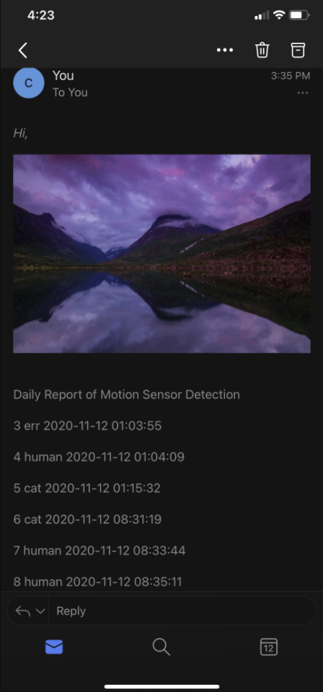
A Sample Email

Slide 11
What’s Next
Limitation:
Accuracy on motion detection
Hard to decide a proper trigger frequency
Audio connection – No headphone jack on RPi Zero, need to seek a budget friendly way to play sound
Future Work:
Automatically start & run on each re/boot
A front-end website for checking status
More accurate object detection

Slide 12
Thank you! Questions?

